Slide 1


Design Patterns
Decorator

Slide 2

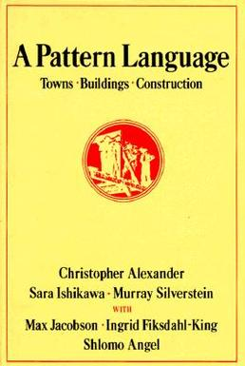
Requisite Background Slide
“Reusable solution to a commonly occurring problem within a given context in software design” – Wikipedia
1987 – Kent Beck and Ward Cunningham, inspired by architectural pattern work, presented idea for software design patterns
1994 – “Gang of Four” published Design Patterns: Elements of Reusable Object-Oriented Software

Slide 3
Pattern Basics
Name
Type / Classification
(creational, structural, behavioral, concurrency)
Intent
Solution
Consequences

Slide 4
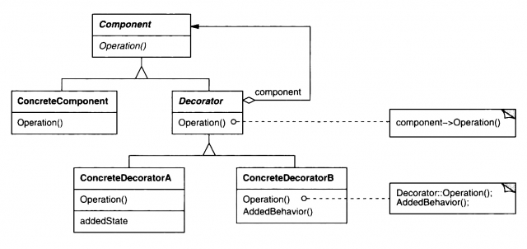
Decorator Pattern
Type: structural
Intent: “Attach additional responsibilities to an object dynamically. Decorators provide a flexible alternative to subclassing for extending functionality” (GOF)

Slide 5
Decorator Pattern
Examples
Common demos include adding logging or timing to methods
Stream decorators in C# - BufferedStream, CryptoStream, GZipStream
Pros
Runtime rather than compile time, more flexibility
Open / Closed Principle
Help deal with permutation issues
Cons
Can result in many small objects
Decorator usually coupled tightly to a specific class / interface
S | Single Responsibility Principle
O | Open / Closed Principle
L | Liskov Substitution Principle
I | Interface Segregation Principle
D | Dependency Inversion Principle

Slide 6

Decorator Pattern
Decorator 3
Decorator 2
Decorator 1
Base Object

Slide 7
Demo

Slide 8
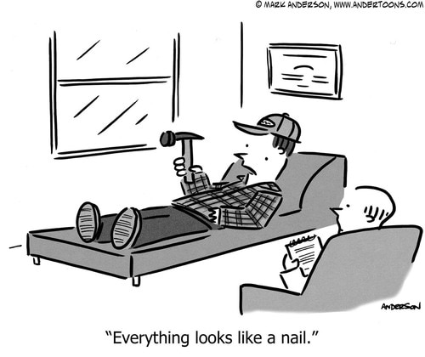
Disclaimer

